Slide 1

NoSQL Databases for Big Data Storage:
Arjun Vankani
Modern businesses generate massive volumes of data; traditional databases are not always effective.

Slide 2
What is NoSQL?
Expand: NoSQL = “Not Only SQL”
Class of database management systems identified by non-relational, distributed data storage models.
Originated around 2009 to address web-scale, real-time data challenges.
Why NoSQL?
Designed to accommodate big data, agile development, and cloud computing.
Relaxed consistency (BASE: Basically Available, Soft state, Eventually consistent).
NoSQL doesn’t reject SQL, but extends data management options.

Slide 3
Why Not Traditional SQL Databases for Big Data?
Rigid Schema: Changing data structures is hard in RDBMS.
Scalability Issues: Scaling vertically (better hardware) is expensive and limited.
Join Complexity: Complex relations slow performance in giant datasets.
Big Data Needs: RDBMS struggles with Velocity, Volume, and Variety.
Example: Social media posts, IoT data, logs—variable and massive; don’t fit standard tables.

Slide 4
Table 1: students
Table 2:enrollments
student_id | name | age
1 | Amit | 20
2 | Priya | 21
3 | Rahul | 20
4 | OM | 18
enrollment_id | student_id | course
101 | 1 | Math
102 | 2 | Science
103 | 1 | English
104 | 3 | English
Get the names of students and the courses they are enrolled in.
Get all students with their courses (if any), including students who are not enrolled in any course.
Get the names of students and the total number of courses each student is enrolled in.
Include students who are not enrolled in any course (show the count as 0 for them).
Notes:
SELECT students.name, enrollments.course
FROM students
INNER JOIN enrollments ON students.student_id = enrollments.student_id;
SELECT students.name, enrollments.course
FROM students
LEFT JOIN enrollments ON students.student_id = enrollments.student_id;
SELECT
students.name,
COUNT(enrollments.course) AS total_courses
FROM
students
LEFT JOIN
enrollments ON students.student_id = enrollments.student_id
GROUP BY
students.name;

Slide 5
RDBMS vs. NoSQL: A Fundamental Comparison
Understanding the core differences between RDBMS and NoSQL is crucial for selecting the appropriate database for your application.
While RDBMS prioritizes data integrity and structured relationships, NoSQL prioritizes flexibility, scalability, and performance for large, unstructured, or semi-structured datasets.

Slide 6
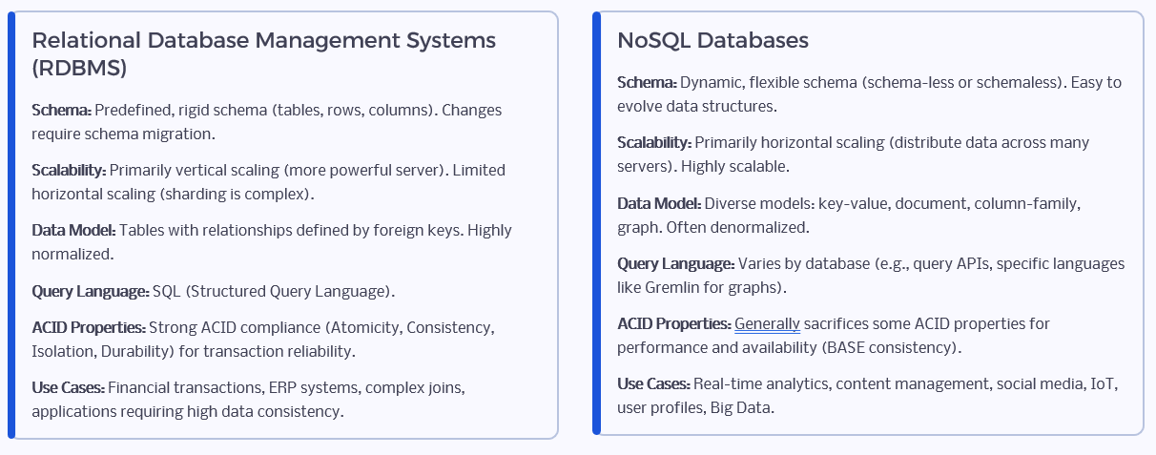
RDBMS vs NOSQL

Slide 7
Core Features of NoSQL
Schema-less data storage – adapt to changes instantly.
Horizontal scaling: Add commodity servers to expand capacity seamlessly.
Distributed architecture—resilient to server/network failures.
Flexible data models: Handle structured, semi-structured, and unstructured data.
Open-source availability (most NoSQL DBs are open and community-driven).
Lower hardware/software cost due to scaling.

Slide 8
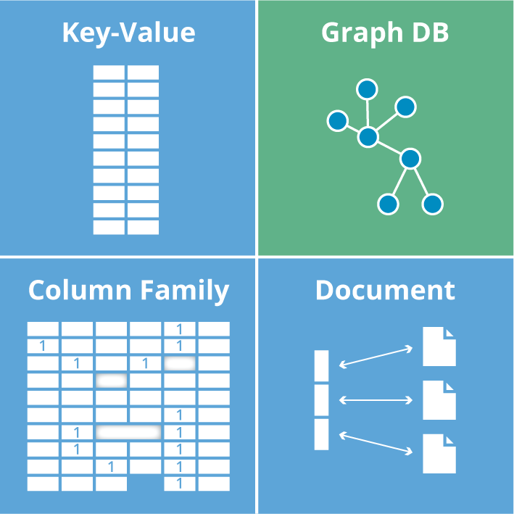
Types of NoSQL Databases
1) Document-based
2) Key-Value Stores
3) Column-Family Stores
4) Graph Databases

Slide 9
1) Document-based
{
"name": "Priya",
"age": 22,
"isStudent": true
}
Data is stored as documents (usually JSON or BSON).
Each document can have any structure or fields — there is no fixed schema.
Documents are grouped into collections.
Highly flexible; fields can differ between documents.
Supports nested values (arrays, embedded documents).
Powerful querying and indexing (you can search by any value in the document).
Often supports ACID transactions within one document.

Slide 10
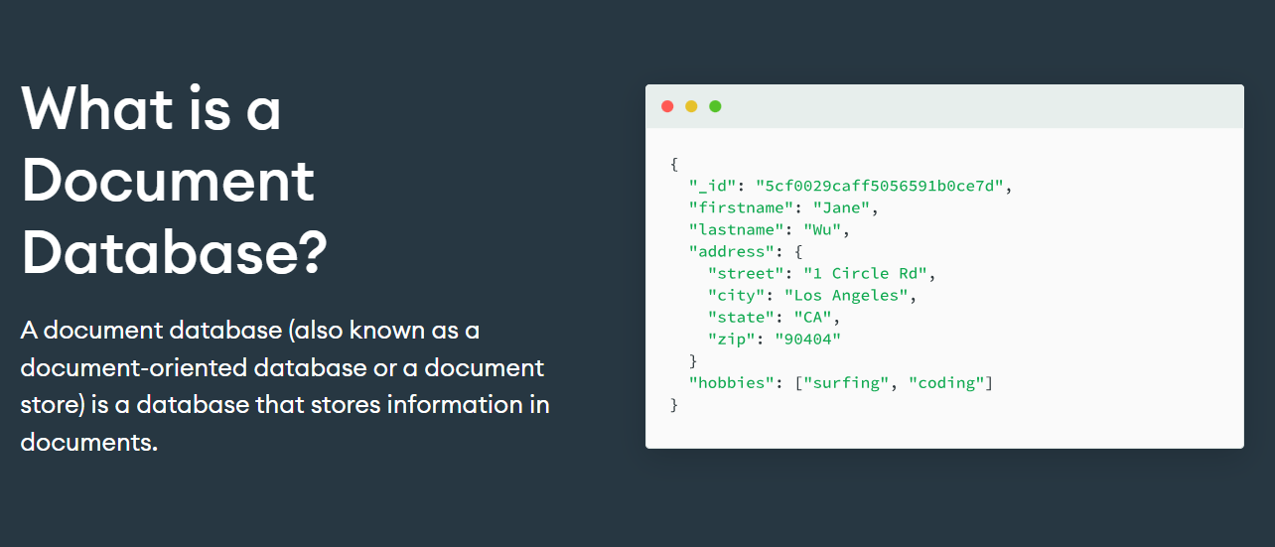
1) Document-Based Database Structure

Slide 11
1) Document-based
Use cases:
Content Management Systems (CMS) where items vary in structure.
User profiles—each user may have unique properties.
Product catalogues (e-commerce): products can have different attributes.
MongoDB
Documents are stored in “collections”.
Powerful aggregation, indexing, and rich query language.
Supports replication and sharding for scalability.
Accessed by drivers in multiple programming languages.

Slide 12
2) Key-Value Stores
The simplest NoSQL model. Each key is mapped to a single value (which could be a string, number, JSON, etc.).
There is no structure to the value from the database’s perspective.
Very fast for lookups by key — runs in constant time.
No querying by value, only by key.
Can support in-memory operation for ultra-low latency.
Some support data expiration (timeouts), making them good for caches.

Slide 13
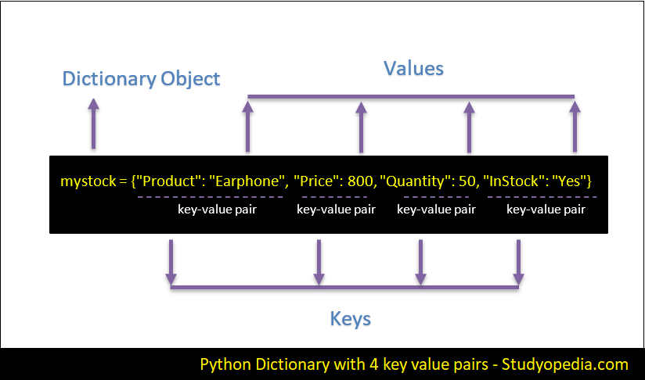
2) Key value Pair

Slide 14
2) Key-Value Stores
Use cases:
Caching (storing session data, tokens, recent activity).
Storing user preferences or shopping cart states.
Leaderboards, counters.
Example
Redis: In-memory, with rich data structures (lists, sets, hashes).
Amazon DynamoDB: Managed, persistent, scalable; also supports secondary indexes.

Slide 15
3) Column-Family Stores (Wide-Column Stores)
Data is stored in tables, but unlike SQL, columns are grouped into families and accessed on demand.
Each row can have a variable number of columns, and columns can be added dynamically.
Efficient for sparse data and massive scale (petabytes).
Optimized for writing and reading huge amounts of data by column.
Good at aggregating and analysing large sets.
Eventual consistency models (not strict ACID).

Slide 16
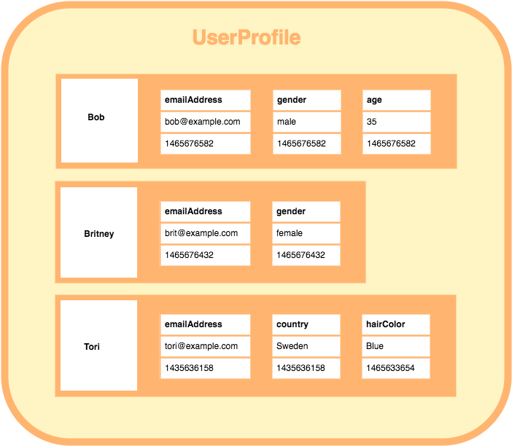
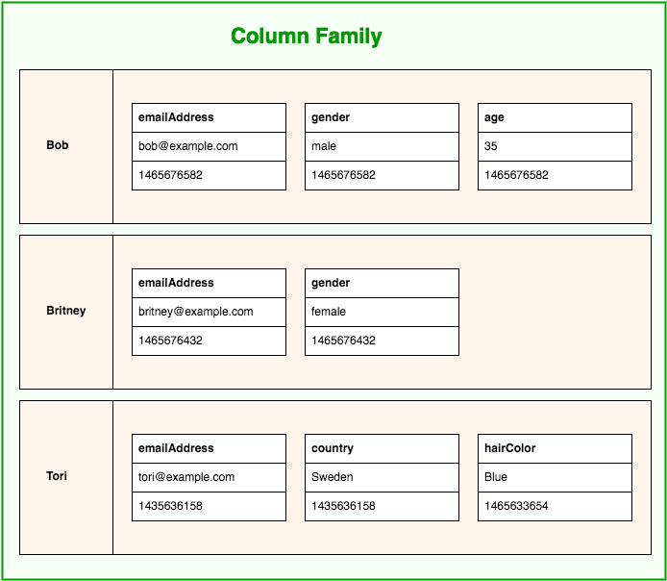
3) Column-Family Stores (Wide-Column Stores)

Slide 17
3) Column-Family Stores (Wide-Column Stores)
Use cases:
Timeseries/log data
Large-scale analytics (IoT, clickstreams)
Real-time recommendation engines where columns are calculated metrics.
Examples:
Apache Cassandra: Peer-to-peer, highly available, no single point of failure.
HBase: Runs on Hadoop, good for big data batch analytics.

Slide 18
4) Graph Databases
Store data as nodes (entities) and edges (relationships between nodes).
Both nodes and edges hold properties. Designed for data with complex relationships, not just tabular info.
Optimized for traversing complex relationships (friend-of-friend, multi-step).
Query languages like Cypher for pattern matching in graphs.
Fast for queries that join or traverse data at multiple levels.
Visualizes data as networks (nodes and links).

Slide 19
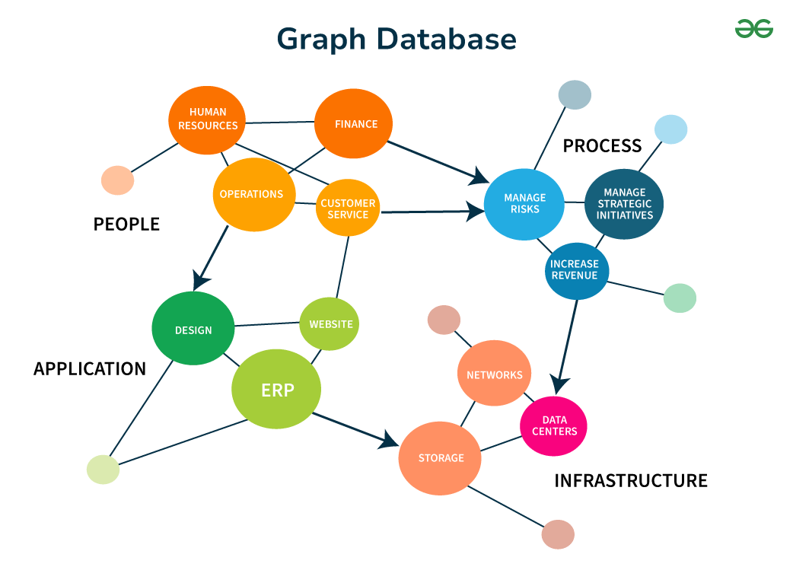
4) Graph Databases

Slide 20
4) Graph Databases
Use cases:
Social networks (friendship relationships, followers).
Fraud detection (track how entities are connected).
Recommendation engines (find users with similar patterns, connections).
Knowledge graphs and network/IT diagrams.
Neo4j:
Most popular enterprise graph DB.
ACID-compliant, flexible schema.
Supports deep traversals, pattern finding, and graph algorithms.

Slide 21
Key Architectural Principles of NoSQL
Sharding: Split data across multiple servers for high performance.
Replication: Duplicate data among nodes for fault tolerance and high availability.
CAP Theorem:
Consistency, Availability, Partition Tolerance.
NoSQL prioritizes Availability & Partition Tolerance.
BASE Model:
Focus is on Basically Available, Soft state, Eventually consistent, rather than strict ACID properties.

Slide 22
Big Data and NoSQL: The 3 Vs
Volume: NoSQL can handle petabytes and beyond (Facebook, Google scale).
Variety: Capable of ingesting multimedia, sensor data, logs, raw feeds, etc.
Velocity: Designed for fast ingest of streaming or batch data.
Example: Storing and querying millions of JSON documents every minute from IoT devices.

Slide 23
Popular NoSQL Databases & Use Cases
MongoDB: News portal content management (rapid changes, hierarchical data).
Cassandra: Banking systems for time-series data, social networks’ message feeds.
Redis: Stock price tickers, online gaming leaderboards (fast key/value access).
Neo4j: Detecting fraud by mapping transaction relationships and finding patterns.

Slide 24
Success Stories
Facebook: Uses Cassandra to manage inbox search, globally distributed and always available.
Netflix: NoSQL (Cassandra & others) for streaming analytics, recommendations, and user activity logs.
Amazon: DynamoDB for retail shopping cart info and user preferences at massive scale.
Google: Bigtable (Column-family) for web indexing, Google Earth, and Google Finance.

Slide 25
Challenges and Future of NoSQL
Consistency vs. Availability: Eventual consistency may not suit all apps (e.g. banking transactions).
Security: Newer models; require extra configuration and awareness.
Ecosystem: Maturity varies—vendor/community support matters.
Skill Gap: Learning curve for teams used to relational DBs.
The Future:
Growth in hybrid DBs (multi-model: supporting both SQL and NoSQL).
Strong adoption for AI, IoT, real-time analytics.
Ongoing research in distributed systems for more robust, easy-to-use NoSQL tools.

Slide 26
Difference between RDBMS and NoSQL databases
Aspect | RDBMS (Relational) | NoSQL (Non-Relational)
Data Model | Table-based (rows & columns) | Document, Key-Value, Column-Family, or Graph
Schema | Fixed, predefined schema; strict structure | Dynamic, flexible schema; can be schema-less
Data Integrity | Enforces ACID properties (Atomicity, Consistency, Isolation, Durability) | Follows BASE model (Basically Available, Soft state, Eventually consistent)
Scalability | Vertical (scale up by adding more power to existing server) | Horizontal (scale out by adding more servers/nodes)

Slide 27
Difference between RDBMS and NoSQL databases
Aspect | RDBMS (Relational) | NoSQL (Non-Relational)
Query Language | SQL (Structured Query Language) – standardized | No standard language; queries with APIs or in JSON, JavaScript, etc.
Relationship Support | Strong (foreign keys, joins) | Limited or no join support; relationships handled differently (e.g., in Graph DBs)
Transaction Support | Strong transaction control (multi-row, multi-table) | Limited/full transactions depend on DB type; often eventual consistency

Slide 28
Difference between RDBMS and NoSQL databases
Aspect | RDBMS (Relational) | NoSQL (Non-Relational)
Performance | High for structured and moderate data volumes | Optimized for large-scale, unstructured/semi-structured data and high-throughput
Examples | MySQL, PostgreSQL, Oracle, MS SQL Server | MongoDB, Cassandra, Redis, Neo4j, Couchbase
Best Use Cases | Banking, ERP, CRM, applications with strict structure/consistency | Social networks, IoT, analytics, real-time web apps

Slide 29
CAP theorem
The CAP theorem, also known as Brewer’s theorem, is a fundamental principle in the design of distributed database systems. It states that a distributed data system can provide only two out of the following three guarantees at any one time:
Element | Description
C: Consistency | Every read receives the most recent write or an error (all nodes see the same data at the same time).
A: Availability | Every request receives a (non-error) response, regardless of the state of any individual node (system is always up).
P: Partition Tolerance | The system continues to operate even if messages are lost or some nodes cannot communicate (network failures between nodes).

Slide 30
CAP
In the presence of a network partition (P)—a break in communication between parts of the system—the system must choose between:
Consistency (C): Refusing to respond to some requests (losing availability) in order to ensure that clients only see up-to-date/identical data.
Availability (A): Responding to all requests (possibly with outdated data), sacrificing perfect consistency.
No distributed system can simultaneously provide all three—Consistency, Availability, and Partition Tolerance—especially during a network failure.

Slide 31
CAP (Database Examples)
CP Systems (Consistency + Partition Tolerance): HBase, MongoDB (default mode)
AP Systems (Availability + Partition Tolerance): Couchbase, Cassandra, DynamoDB
CA Systems (Consistency + Availability): Not possible in a distributed system with network partitions
In distributed systems during partition, designers must choose to prioritize either consistency or availability but not both together.
This is why NoSQL systems often choose AP or CP, depending on the use case.

Slide 32
CAP Summary
System Type | Consistency | Availability | Partition Tolerance | Example
CP | Yes | No | Yes | MongoDB (default), HBase
AP | No | Yes | Yes | Cassandra, Couchbase
CA | Yes | Yes | No | Single-node RDBMS (not distributed)

Slide 33
Data Modelling in NoSQL
Schema Flexibility:
NoSQL supports dynamic, schema-less models—documents, key-values, columns, or graphs.
New fields can be added any time without altering a central schema.
Denormalization:
Redundant data is common; avoids costly JOIN operations.
Common in document and column-family databases (e.g., product details copied into many “order” documents).

Slide 34
Data Modelling in NoSQL
Entity Embedding vs. Referencing:
Embedding: Place related data within the same document (best for 1:1 or 1:many).
Referencing: Use IDs/pointers to link separate documents/records (for large “many-to-many” relations).
Data Access Patterns:
Design your model based on application’s query requirements (“query-driven modeling”).
Example (MongoDB): Store all user profile and orders in a single document for quick user page loads.

Slide 35
Sharding in NoSQL
Sharding = Partitioning data across multiple servers/nodes (“shards”).
Used to achieve horizontal scalability for massive datasets.
A value or attribute used to determine data distribution (e.g., user ID, region).
Queries and writing spread across servers = better performance.
No single server becomes a bottleneck.
Picking the right shard key is crucial—bad keys can cause uneven data (“hot spots”).

Slide 36
Types of Sharding:
Range-Based: Data split based on value range (e.g., dates).
Hash-Based: Use a hash function on the shard key (spreads data evenly).
Directory-Based: Uses a lookup table to find which shard holds data.

Slide 37
Replication in NoSQL
Copying data between multiple nodes to ensure availability and fault tolerance.
Master-Slave (Primary-Secondary): One node (master) accepts writes, others (slaves) replicate and serve reads.
Peer-to-Peer (Multi-Master): All nodes can accept writes and replicate to each other (used in Cassandra, Couchbase).

Slide 38
Replication in NoSQL
Data persists even if some nodes fail.
Improves read throughput (reads distributed across replicas).
Supports geo-distributed applications (local replicas for faster access).
Trade-Offs:
Trade between consistency and availability (related to CAP theorem).
Replication lag—replicas might not always be perfectly up-to-date.

Slide 39
Summary
Technique | Goal | Common Use in NoSQL | Example Systems
Data Modeling | Performance, scalability | Document/Key-Value/Column Graph | MongoDB, Cassandra, Neo4j
Sharding | Horizontal scaling | Partitioned data storage | MongoDB, Cassandra
Replication | Fault tolerance | Master-slave or peer-to-peer | MongoDB, Cassandra

Slide 40
Thank you

